Slide 1






ARA case study
A tiered approach to the assessment of inhaled cobalt compounds
Ruth Danzeisen and Vanessa Viegas
Cobalt Institute

Slide 2
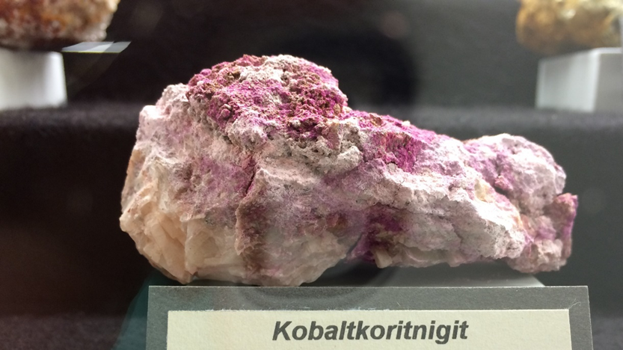
Notes:
Kobaltkoritnigit = (Co,Zn)(HAsO4) · H2O

Slide 3

Occurs naturally in rock and soil
Rechargeable batteries
Essential to bacteria and core of Vit B12
Electronics
Catalysts
Transition metal
Inks, pigments
Common in biology/nature 2+ ion
Alloys
Unique properties
Hazard profile

Slide 4
Co “five soluble salts”* hazard profile
* -dichloride, -sulfate, -dinitrate, -acetate, -carbonate
„Clear evidence” for carcinogenic activity of Co sulfate (inhalation exposure) in male/female F344/N rats and male/female B6C3F1/N“
based on alveolar/bronchiolar adenoma and carcinoma in the lung
Endpoint | Skin sens | Resp sens | Germ cell muta | Carc | Repr
EU CLP section | 3.4 | 3.4 | 3.5 | 3.6 | 3.7
Classification category | 1 | 1 | 2 | 1B, H350i | 1B, H360F

Slide 5
Co metal hazard profile
„Clear evidence” for carcinogenic activity of Co metal powder (inhalation exposure) in male/female F344/Ntac rats and male/female B6C3F1/N“
based on alveolar/bronchiolar adenoma and carcinoma in the lung
Endpoint | Skin sens | Resp sens | Germ cell muta | Carc | Repr
EU CLP section | 3.4 | 3.4 | 3.5 | 3.6 | 3.7
Classification category | 1 | 1 | 2 | 1B, H350 | 1B, H360F

Slide 6
MoA “as we now it”
DNA repair, apoptosis
Mutations
Ion
Channels
Co²⁺ ions
Cytotoxicity
Alveolar and bronchiolar adenoma and carcinoma
Intracellular Co²⁺
Hypoxia (HIF-1α stabilisation
Metabolic shift / angiogenesis
Co particles
Genotoxicity
Endo-
cytosis
Inflammation
Reactive oxygen species
Surface corrosion
Adapted from Lison et al 2018 Critical Reviews in Toxicology Volume 48, Issue 7

Slide 7
Selection of markers for testing
Mutations
Co²⁺ ions
Cytotoxicity
Hypoxia (HIF-1α stabilisation
Genotoxicity
Inflammation
Reactive oxygen species

Slide 8
Limited testing – why?
More than 25 Co compounds in Cobalt Institute Portfolio
Many more Co compounds in use
Cannot test each compound in a carcinogenicity study (animal welfare, timing, cost)
Need to clarify presence of hazard seen in some Co compounds (e.g. Co metal) versus other less studied compounds
Desire to use least hazardous substance in any (industrial) application

Slide 9
Comparison of 2 Co compounds
Co metal powder
Co₃O₄ powder
Powder form with inhalability / respirability
Low water solubility
High Co content
Many uses, high tonnage
High purity grades suitable for testing
99.99% Co
Known hazard profile for chronic endpoints and Carc, Muta, Repr
72.4% Co
Hazard profile for chronic endpoints (Carc, Repr) not fully known
No classification for Muta

Slide 10
Markers and test systems
Cytotoxicity
Hypoxia
Sub/Chronic inflammation
Acute and ‘persistent’ lung inflammation
Co²⁺ ions
Oxidative stress
Genotoxicity
(8-Oxoguanine)
Genotoxicity and Mutations

Slide 11
Tier 1: Release of the Co²⁺ cation
Method
MoA
RESULTS
 | TIER 1 Solubility in lung fluids
 | Ion Release (µg Co/ml)
 | Int. | Alv. | Lys.
Co metal powder | 75 | 40 | 1907
Tricobalt tetraoxide | 0.05 | 0.08 | 22
Cytotoxicity
Test in artificial lung fluids
  Interstitial (neutral pH)
  Alveolar (neutral pH with surfactant)
  Lysosomal (acidic pH)
  Determine amount of Co²⁺ released (toxic moiety of interest)
Tricobalt tetraoxide
Poorly soluble
Co metal
Moderately soluble in pH neutral,
Highly soluble in acidic pH
Ion
Channels
Co²⁺ ions
Hypoxia
Alveolar and bronchiolar adenoma and carcinoma
Intracellular Co²⁺
‘Persistent’ lung inflammation
Sub/Chronic inflammation
Co particles
Oxidative stress
Endo-
cytosis
Genotoxicity

Slide 12

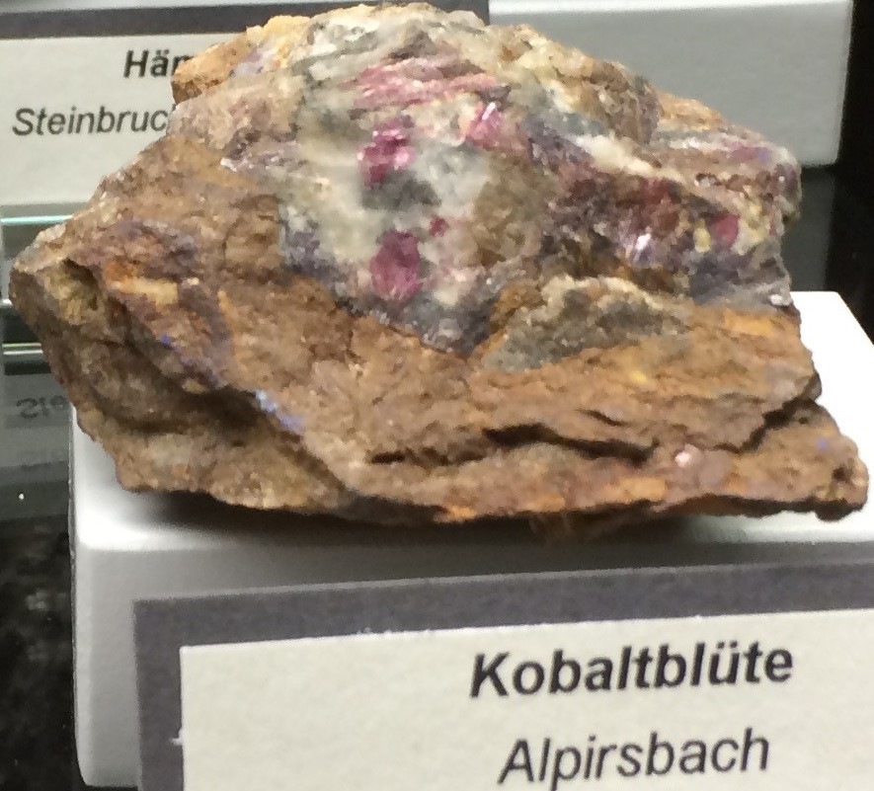
Tier 1: potential stumbling blocks?
Co complex in solution
Which fluid is driver?
Add release concentrations from different compartments?

Slide 13
Tier 2: Biomarkers for cytotox, genotox, hypoxia, oxidative stress
Method
MoA
RESULTS
 | TIER 1 Solubility in lung fluids |  |  | TIER 2 In Vitro Markers
 | Ion Release (µg Co/ml) |  |  | Cyto-tox | Hypoxia | Oxid. Sress | Genotox
 | Int. | Alv. | Lys.
Co metal powder | 75 | 40 | 1907 | + | + | + | -
Tricobalt tetraoxide | 0.05 | 0.08 | 22 | - | - | - | -
ToxTracker®
Direct and indirect genotox reporters
Downstream hypoxia regulated genes
Oxidative stress
Cellular assay (A549 cells)
Cytotoxicity
Hypoxia (HIF-1alpha)
Cytotoxicity
Ion
Channels
Tricobalt tetraoxide
No upregulation of markers
Non-reactive
Co metal
Upregulation of 3 markers
Reactive
Co²⁺ ions
Hypoxia
Alveolar and bronchiolar adenoma and carcinoma
Intracellular Co²⁺
‘Persistent’ lung inflammation
Sub/Chronic inflammation
Co particles
Oxidative stress
Endo-
cytosis
Genotoxicity

Slide 14
Tier 2: potential stumbling blocks?
Differential responses in other cell types
e.g. upregulation of HIF1-alpha by Co₃O₄ in BEAS-2B cells at high doses
Which (combination of) responses are sufficient for cancer?

Slide 15
Tier 3: ‘Persistent’ inflammation
Method
MoA
RESULTS
 | TIER 1 Solubility in lung fluids |  |  | TIER 2 In Vitro Markers |  |  |  | TIER 3 In vivo
 | Ion Release (µg Co/ml) |  |  | Cyto-tox | Hypoxia | Oxid. Sress | Genotox | Persist. Inflamm.
 | Int. | Alv. | Lys.
Co metal powder | 75 | 40 | 1907 | + | + | + | - | ++
Tricobalt tetraoxide | 0.05 | 0.08 | 22 | - | - | - | - | -
Tricobalt tetraoxide
Persistent inflammation
Non-reactive
Co metal
Persistent inflammation
Reactive
Acute toxicity test (OECD 436)
  + histopathology
  + interim sacrifices
Cytotoxicity
Ion
Channels
Co²⁺ ions
Hypoxia
Alveolar and bronchiolar adenoma and carcinoma
Intracellular Co²⁺
‘Persistent’ lung inflammation
Sub/Chronic inflammation
Co particles
Oxidative stress
Endo-
cytosis
Genotoxicity

Slide 16
Tier 3: potential stumbling blocks?
Lack of local concordance between marker of “reactivity” and ultimate adverse outcome
  E.g. larynx metaplasia and alveolar bronchiolar adenoma carcinoma
Is it possible to determine the nature of the “persistent inflammation” as acute or chronic?
How are cobalt-related acute inflammation and cobalt-related chronic inflammation related
  or are they separate events?

Slide 17
Tier 4: 28-day RDT inhalation study with tricobalt tetraoxide
Method
MoA
RESULTS
 | TIER 1 Solubility in lung fluids |  |  | TIER 2 In Vitro Markers |  |  |  | TIER 3 In vivo | TIER 4 In vivo
 | Ion Release (µg Co/ml) |  |  | Cyto-tox | Hypoxia | Oxid. Stress | Geno-tox | Persist. Inflamm | 28 day RDT
 | Int. | Alv. | Lys.
Co metal powder | 75 | 40 | 1907 | + | + | + | - | ++ | See comment
Tricobalt tetraoxide | 0.05 | 0.08 | 22 | - | - | - | - | - | -
Cytotoxicity
Ion
Channels
Tricobalt tetraoxide
Response similar to ‘poorly soluble particle’ (PSP) effect
Vs
Reactive substances
- In 14d and 3mo studies: chronic active inflammation and epithelial hyperplasia
28d RDT inhalation study with 90d recovery
(OECD 412)
+ upregulation of hypoxia
+ measure cytokines, 8-OH-dG
(90d RDT inhalation study TBD)
Co²⁺ ions
Hypoxia
Alveolar and bronchiolar adenoma and carcinoma
Intracellular Co²⁺
‘Persistent’ lung inflammation
Sub/Chronic inflammation
Co particles
Oxidative stress
Endo-
cytosis
Genotoxicity

Slide 18
Tier 4: potential stumbling blocks?
Convincing enough for lack of adversity?
How to predict “ultimate” outcome?

Slide 19
Tiered approach results
 | TIER 1 Solubility in lung fluids |  |  | TIER 2 In Vitro Markers |  |  |  | TIER 3 In vivo | TIER 4 In vivo | TIER 5 In vivo | TIER 6 In vivo
 | Ion Release (µg Co/ml) |  |  | Cyto-tox | Hypoxia | Oxid. Stress | Genotox | Persist. Inflamm | 28 day RDT | 90 day RDT | Cancer
 | Int. | Alv. | Lys.
Co metal powder | 75 | 40 | 1907 | + | + | + | - | ++ |  | + | +
Co dichloride | 228 | 340 | 446 | + | + | + | - | RA | RA | RA | RA
Co monoxide | 25 | 9.1 | 1343 | + | + | + | - | + | RA | RA | RA
Tricobalt tetraoxide | 0.05 | 0.08 | 22 | - | - | - | - | - | - | TBD | ?
Co sulfide | 1.2 | 15 | 82 | - | - | - | - | - | RA | RA | RA
Co lithium oxide | 0.05 | 0.05 | 15 | - | - | - | - | - | RA | RA | RA

Slide 20
Overall read across (RA): potential stumbling blocks?
Do we need to conduct a full carcinogenicity bioassay by inhalation for a poorly reactive substance?
Poorly reactive in lower tiers = Poorly reactive in higher tier(s) = Not carcinogenic: is this logic convincing?

Slide 21
Co substances: Read-across approach for inhalation carcinogenicity
Solubility in lung fluids
In vitro markers:
cytotoxicity
hypoxia
oxid.stress
genotox.
Inflammatory reaction after acute inhalation
Repeat dose inflammatory reaction;
Hyperplasia, metaplasia
Sub-chronic inflammatory reaction
Cancer
Chronic inhalation
90d RDT inhalation
Reactivity/Severity of effect
14/28d RDT inhalation
Acute inhalation
In vitro marker
Phys-chem
Property
In vitro marker
Acute inhalation
14/28d RDT inhalation
90d RDT inhalation
Chronic inhalation
Power of information

Slide 22
MoA poorly reactive Co compounds – work in progress
Mutations
Ion
Channels
Co²⁺ ions
Cytotoxicity
Chronic outcome:
?
Intracellular Co²⁺
Hypoxia (HIF-1α stabilisation
Genotoxicity
Poorly soluble Co containing particles
Endo-
cytosis
Inflammation (increase in PMN)
Reactive oxygen species
Notes:
Relative polymorphonuclear neutrophils (PMN) levels increase at mid and high dose

Slide 23
Two types of behaviour, two groups of Co compounds
If substance all “+” or all “–” across tiers = high confidence
“easy” assignment only if no contradictions between tiers
Contradictive results between tiers need to be resolved, by higher tier testing?
Are there other groups, e.g. with “moderate” responses?
Tier of completed testing | Number of comp’nds
1 | 24
2 | 20
3 | 11
4 | 3
Clear assignment of group | 12

Slide 24
Do we need to conduct a full carcinogenicity bioassay by inhalation
for a poorly reactive substance?
Poorly reactive in lower tiers = Poorly reactive in higher tier(s)
=> Not carcinogenic: is this logic convincing?

Slide 25
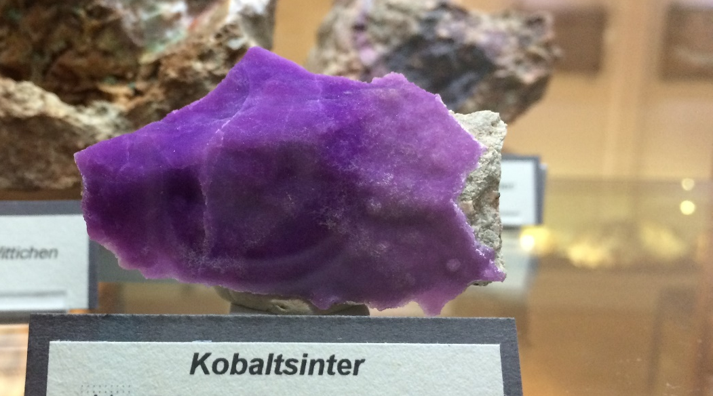
Acknowledgements
Test work: D. Lison, S. v. d. Brule and team, Toxys Team (ToxTracker) and others
Writing method into publication series: all above names,
and i.a. V. Verougstraete, A. Burzlaff, S. Verberckmoes,
D. Warheit, P. Marsh, J. Adam and more...
Notes:
Kobaltsinter = Calcit (CaCO₃) containing Co

Slide 26
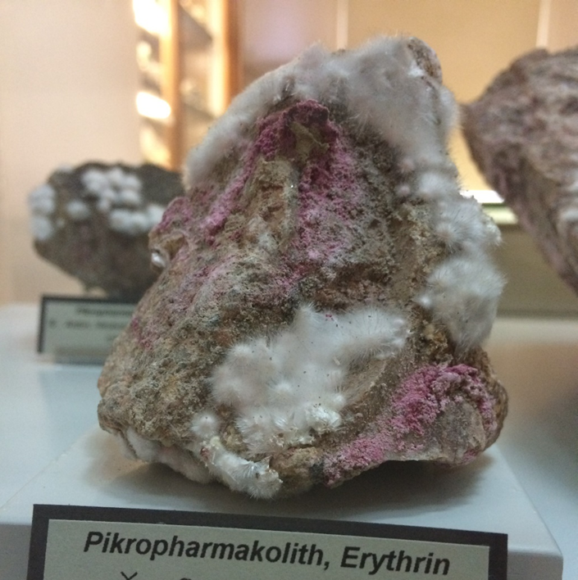
Thank you for your attention!
Ruth Danzeisen rdanzeisen@cobaltinstitute.org
Vanessa Viegas
vviegas@cobaltinstitute.org
www.cobaltinstitute.org
www.cobaltreachconsortium.org
Notes:
Erythrin = Co₃[AsO₄]₂·8H₂O

